Slide 1
Unit 4
The Network Layer

Slide 2
Network Layer Design Isues
•
•
•
•
•
Store-and-Forward Packet Switching Services Provided to the Transport Layer Implementation of Connectionless Service
Implementation of Connection-Oriented Service Comparison of Virtual-Circuit and Datagram Subnets

Slide 3
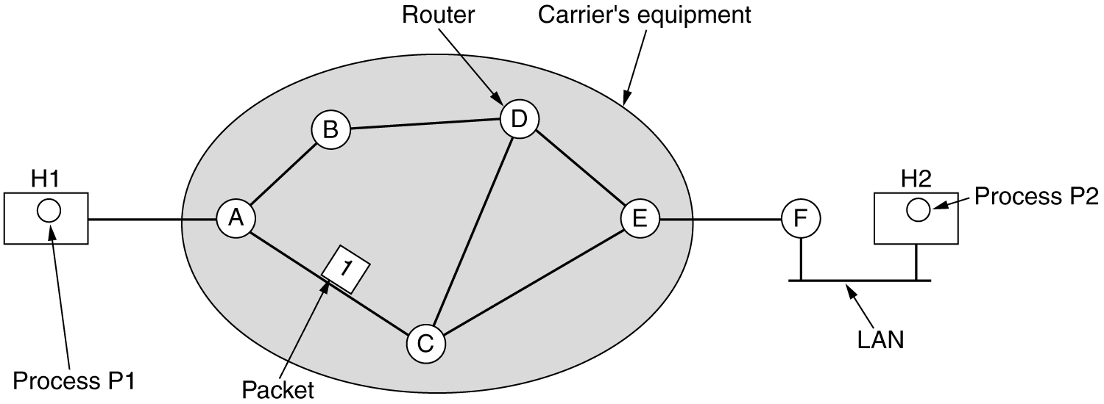
Store-and-Forward Packet Switching
fig 5-1
The environment of the network layer protocols.

Slide 4
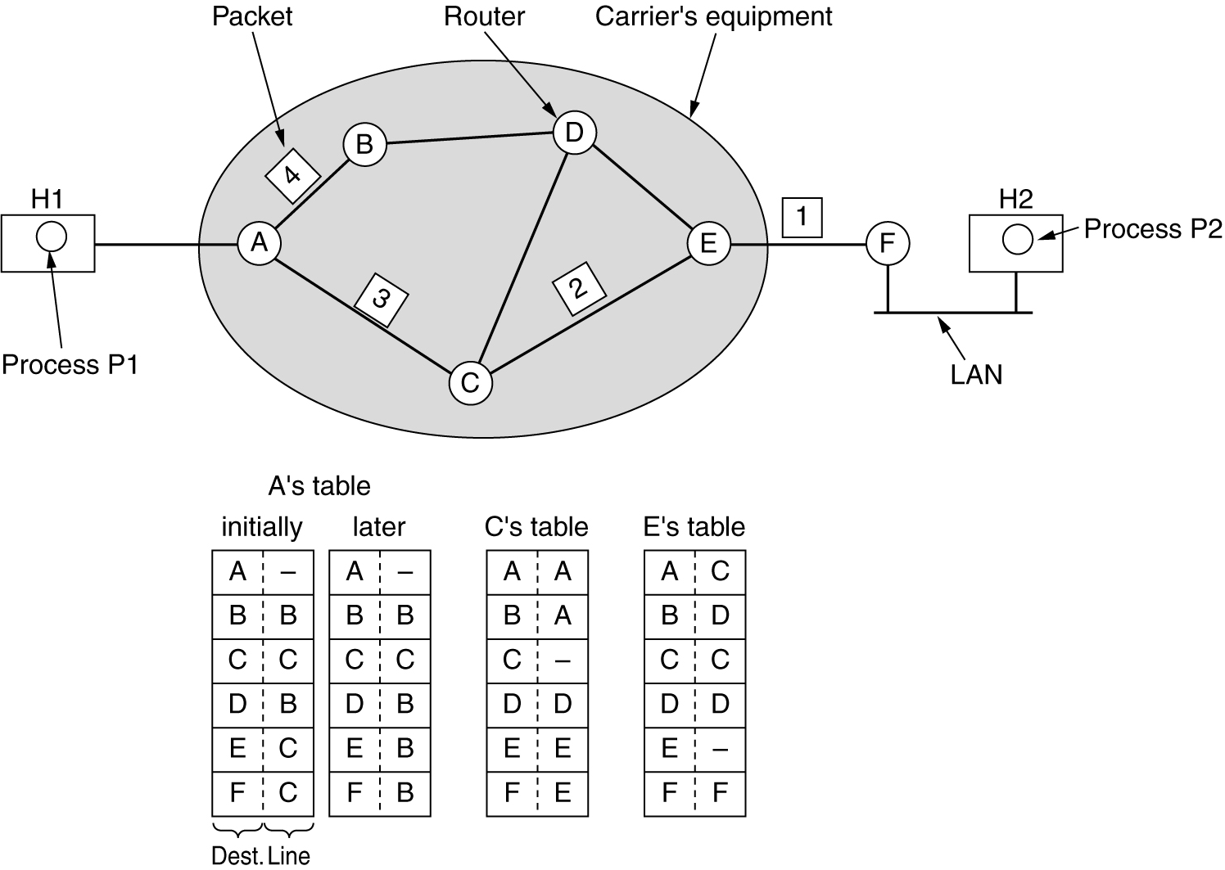
Implementation of Connectionless Service
Routing within a diagram subnet.

Slide 5
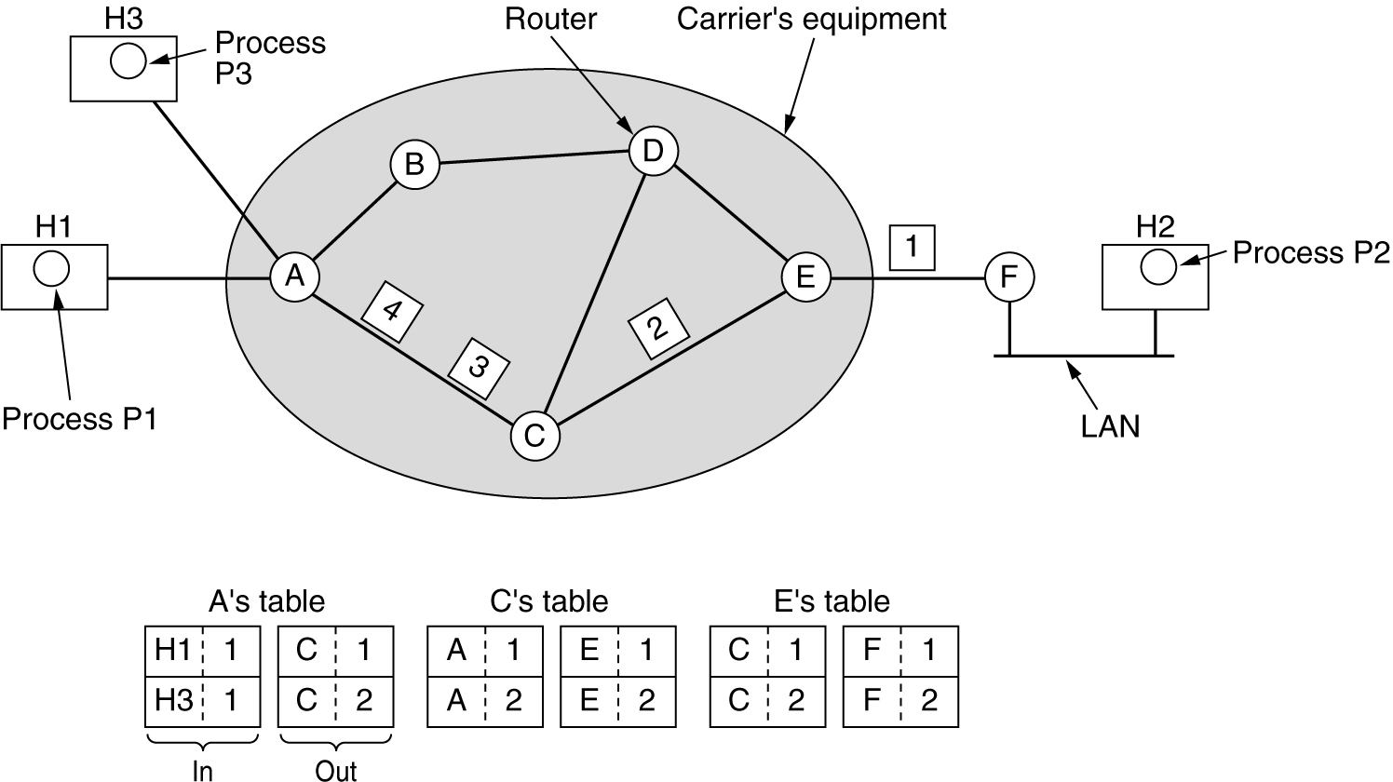
Implementation of Connection-Oriented Service
Routing within a virtual-circuit subnet.

Slide 6
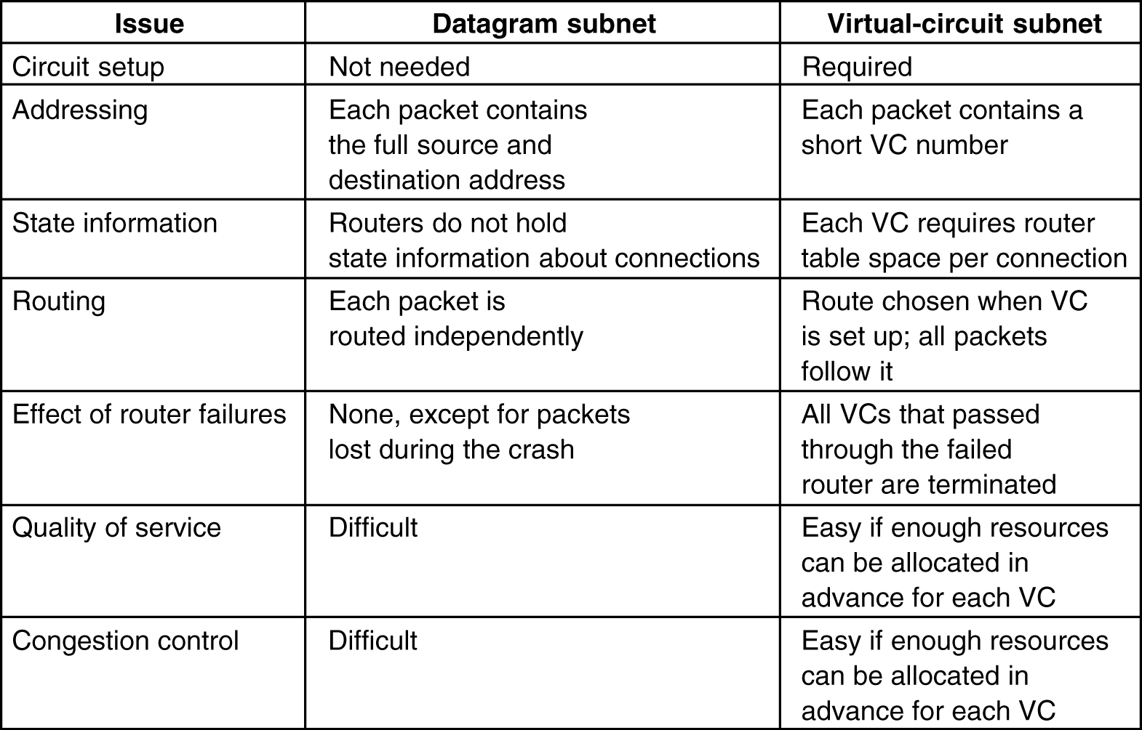
Comparison of Virtual-Circuit and Datagram Subnets
5-4

Slide 7
Routing Algorithms
•
•
•
•
•
•
•
•
•
•
The Optimality Principle Shortest Path Routing Flooding
Distance Vector Routing Link State Routing Hierarchical Routing Broadcast Routing Multicast Routing Routing for Mobile Hosts
Routing in Ad Hoc Networks

Slide 8
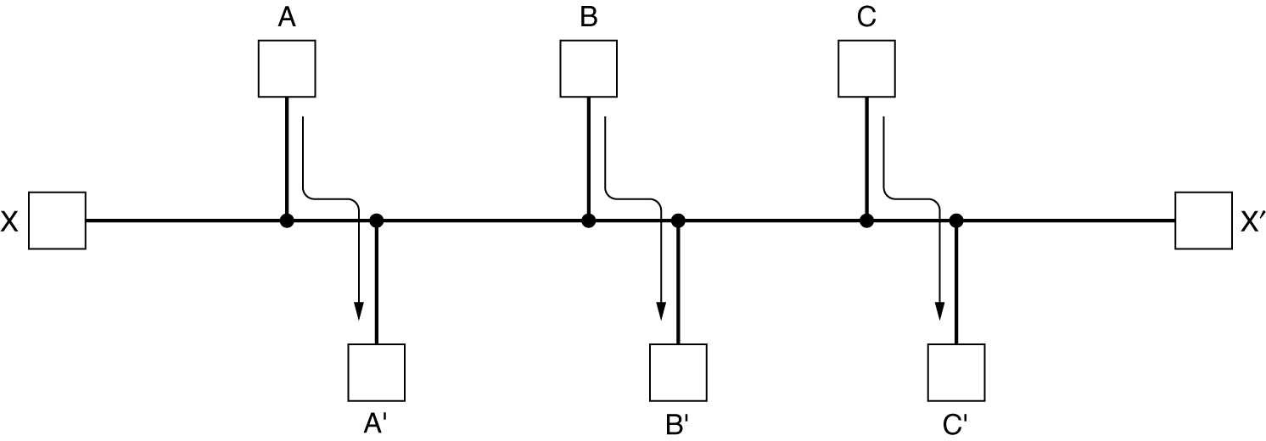
Routing Algorithms (2)
Conflict between fairness and optimality.

Slide 9
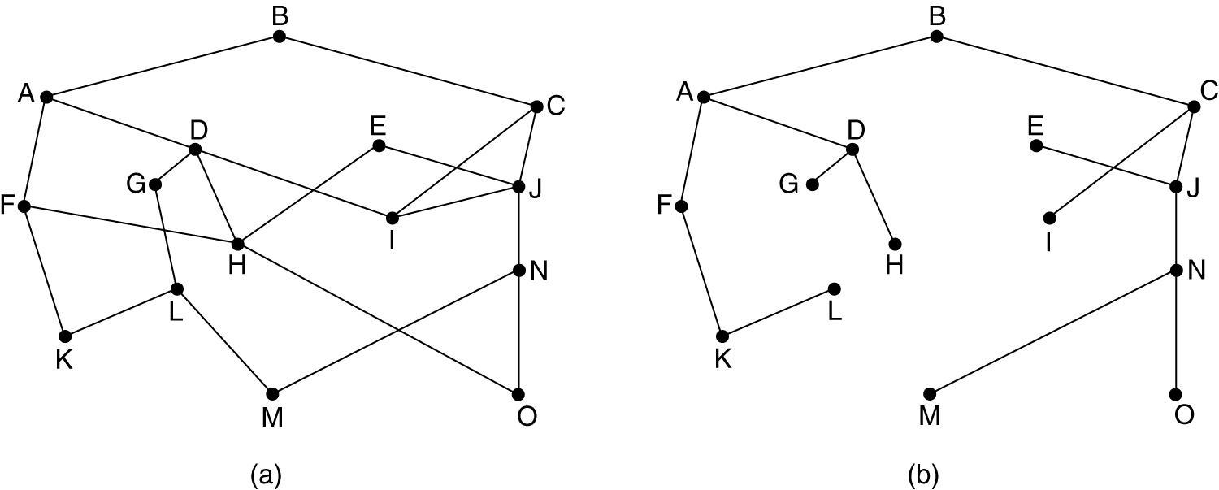
The Optimality Principle
(a) A subnet. (b) A sink tree for router B.

Slide 10
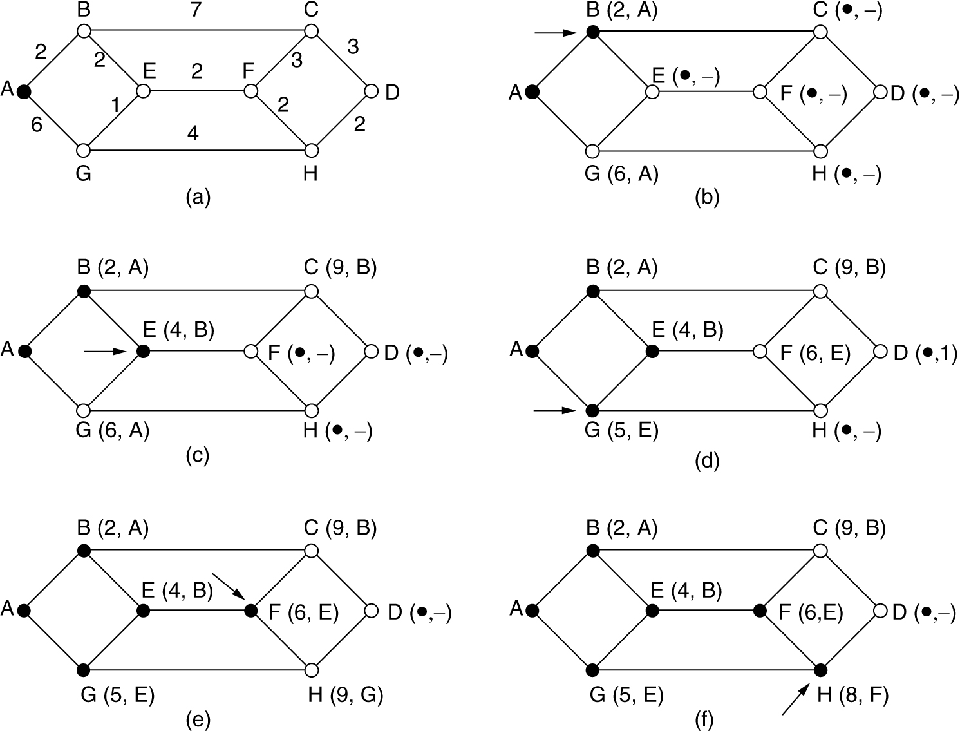
Shortest Path Routing
The first 5 steps used in computing the shortest path from A to D. The arrows indicate the working node.

Slide 11
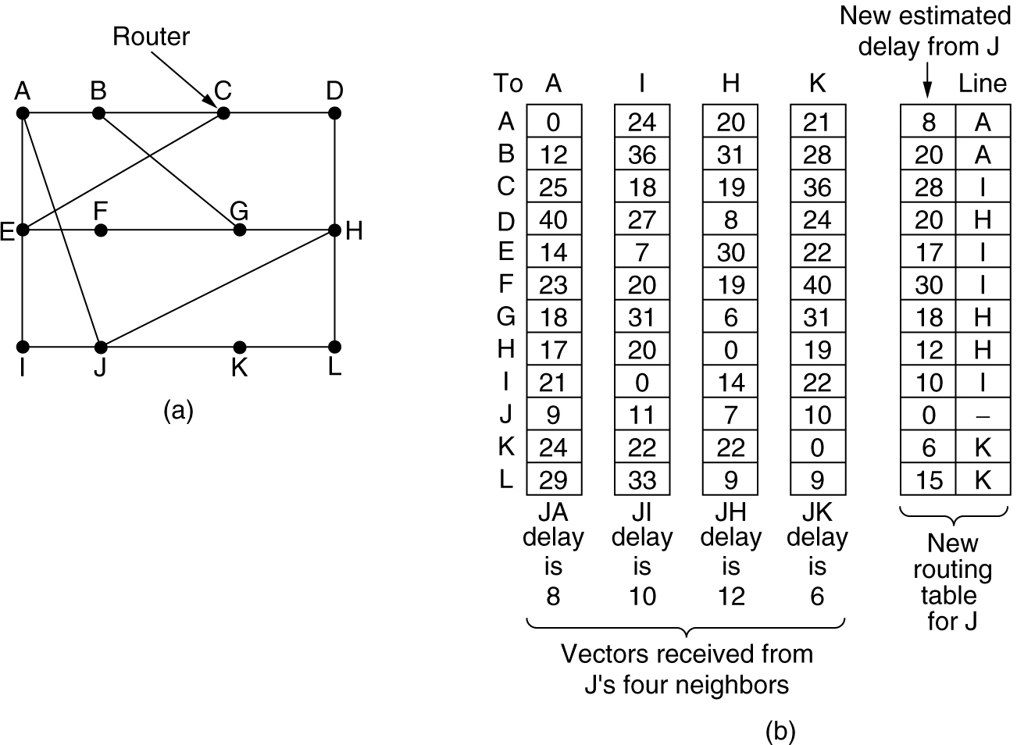
Distance Vector Routing
(a) A subnet. (b) Input from A, I, H, K, and the new routing table for J.

Slide 12
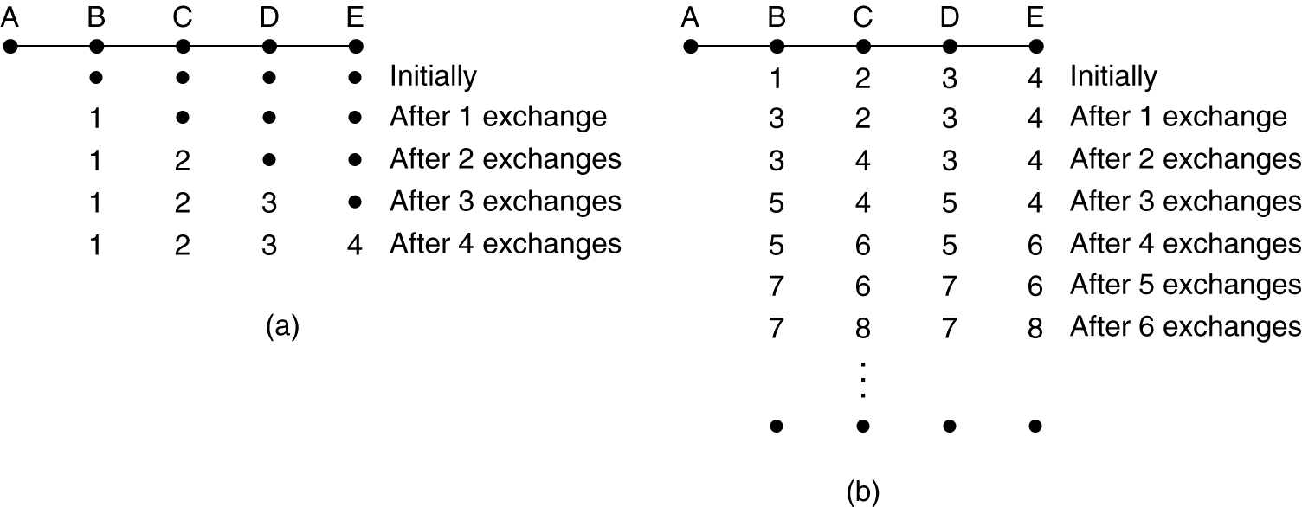
Distance Vector Routing (2)
The count-to-infinity problem.

Slide 13
Link State Routing
Each router must do the following:
Discover its neighbors, learn their network address.
Measure the delay or cost to each of its neighbors.
Construct a packet telling all it has just learned.
Send this packet to all other routers.
Compute the shortest path to every other router.

Slide 14
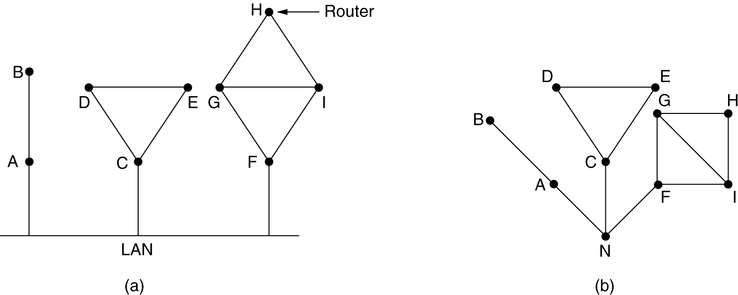
Learning about the Neighbors
(a) Nine routers and a LAN. (b) A graph model of (a).

Slide 15
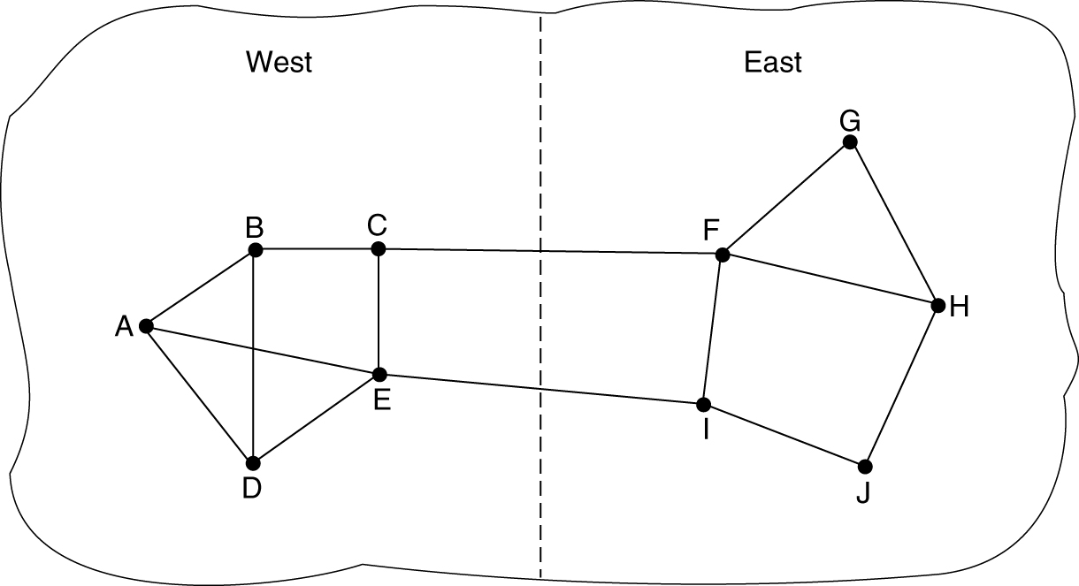
Measuring Line Cost
A subnet in which the East and West parts are connected by two lines.

Slide 16
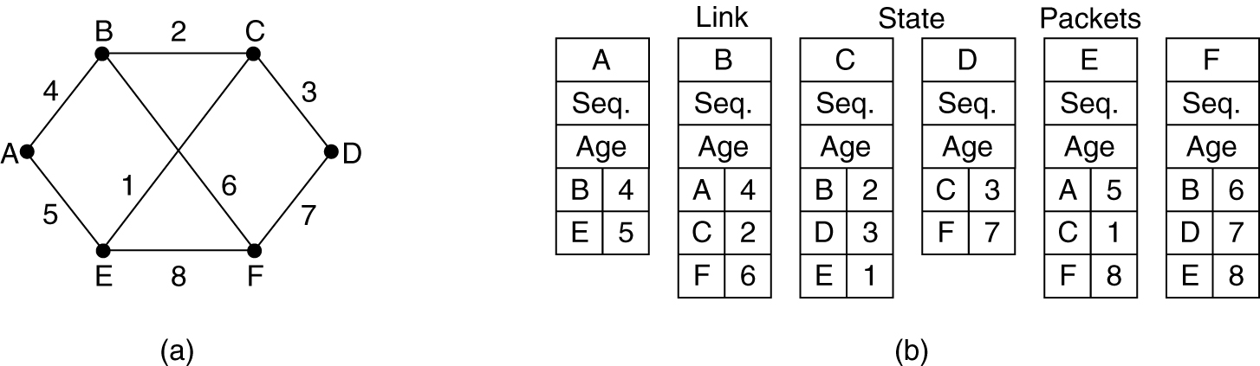
Building Link State Packets
(a) A subnet. (b) The link state packets for this subnet.

Slide 17
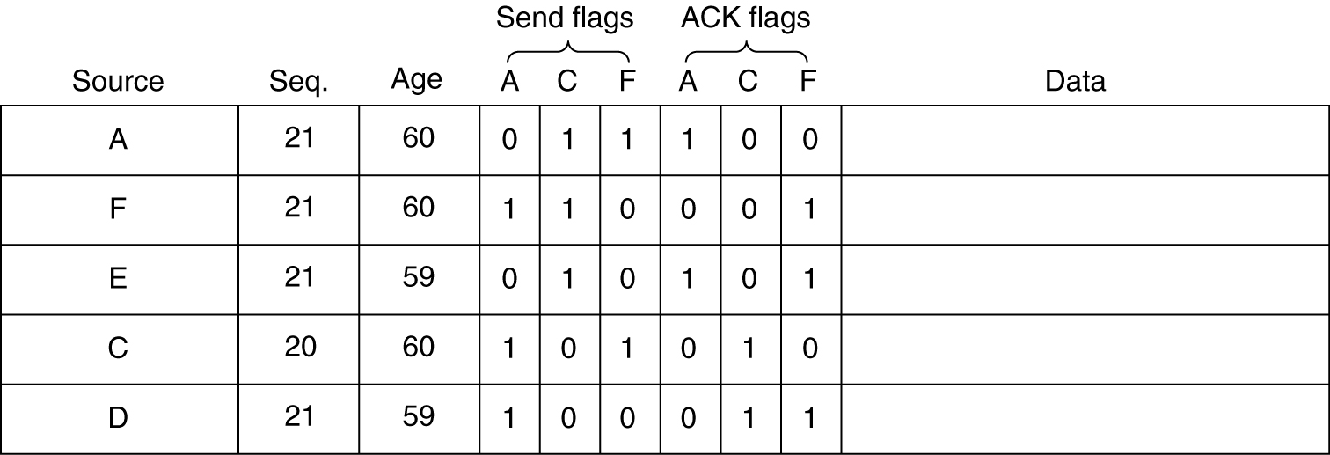
Distributing the Link State Packets
The packet buffer for router B in the previous slide (Fig. 5-13).

Slide 18
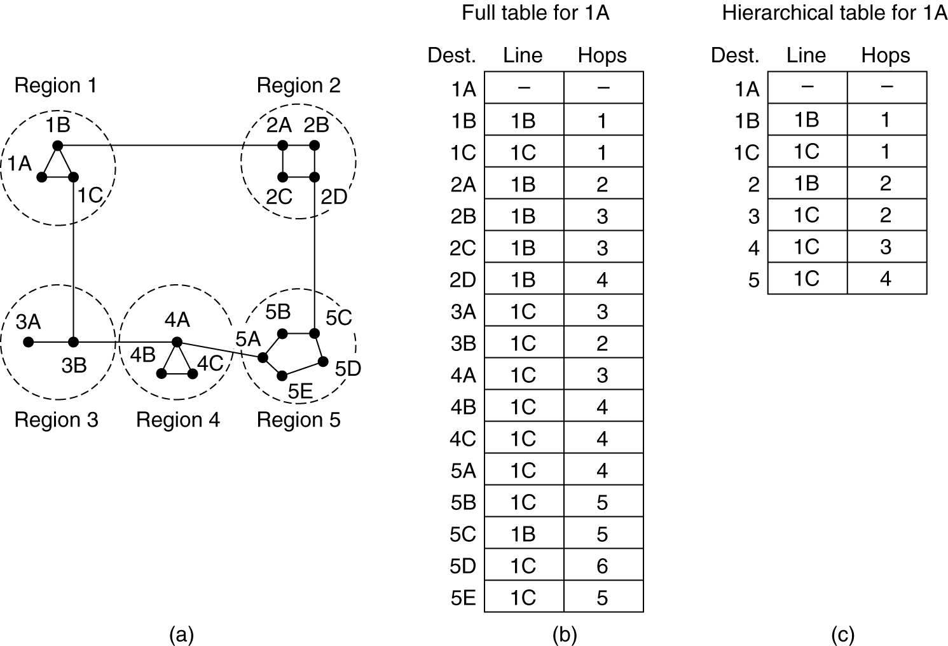
Hierarchical Routing
Hierarchical routing.

Slide 19
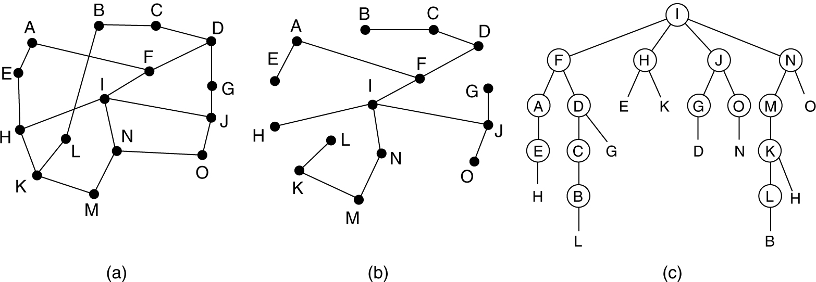
Broadcast Routing
Reverse path forwarding. (a) A subnet. (b) a Sink tree. (c) The tree built by reverse path forwarding.

Slide 20
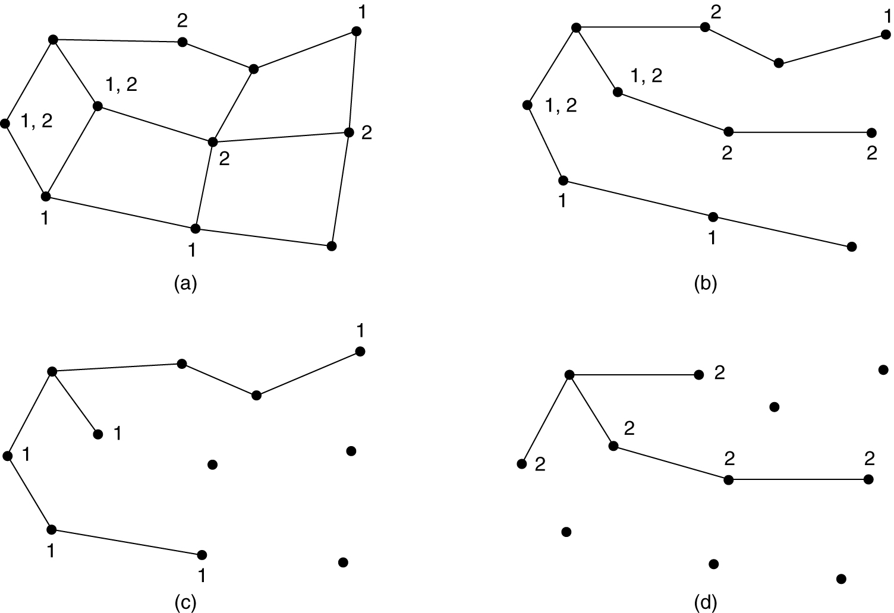
Multicast Routing
(a) A network. (b) A spanning tree for the leftmost router.
(c) A multicast tree for group 1. (d) A multicast tree for group 2.

Slide 21
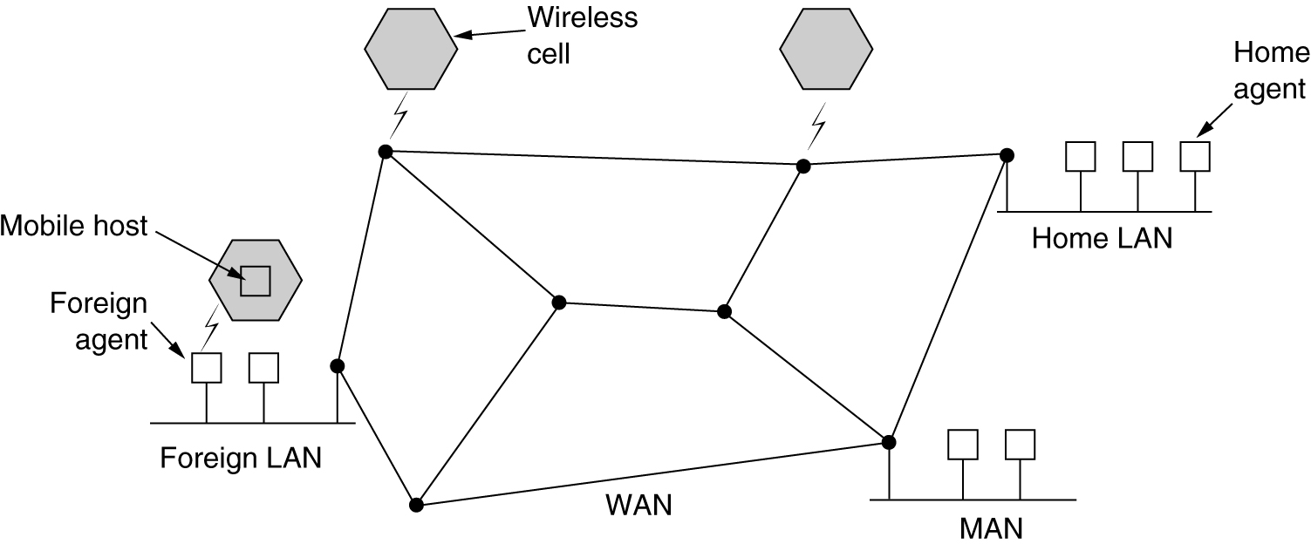
Routing for Mobile Hosts
A WAN to which LANs, MANs, and wireless cells are attached.

Slide 22
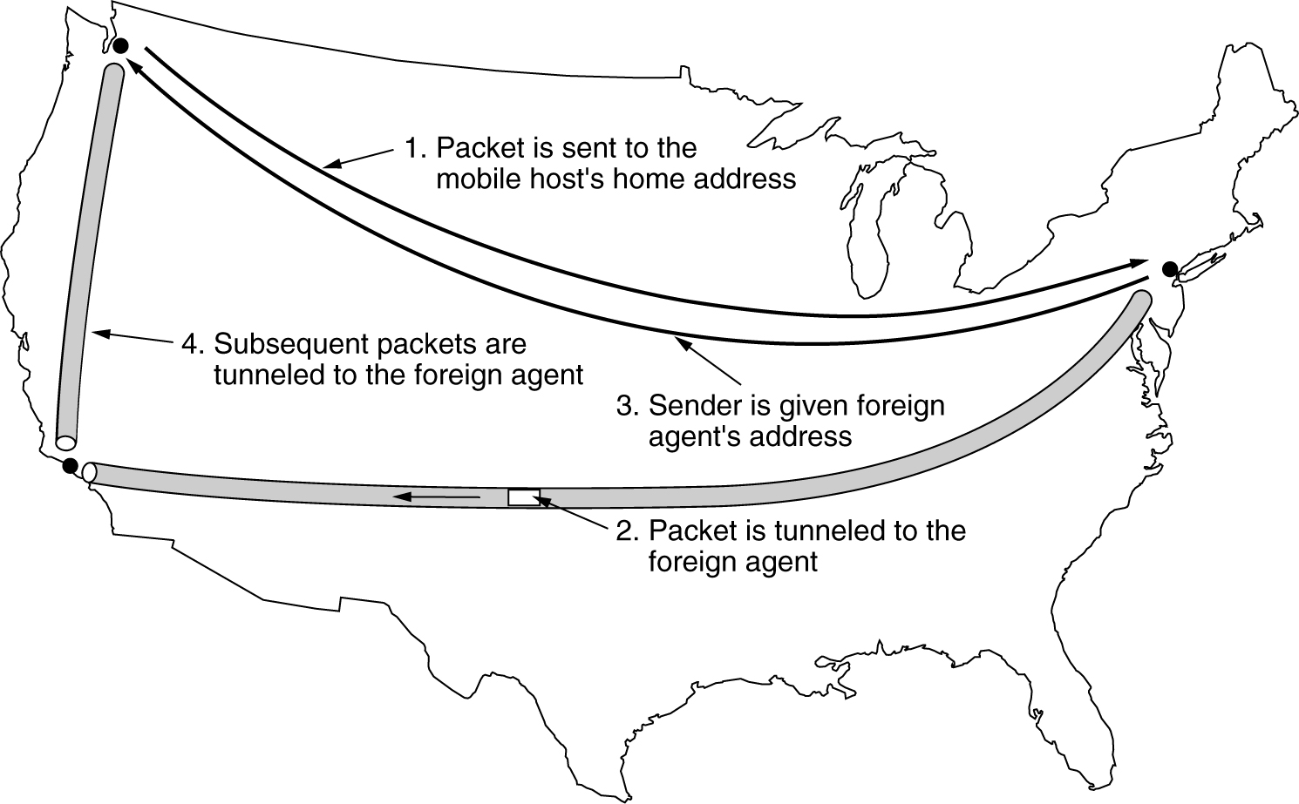
Routing for Mobile Hosts (2)
Packet routing for mobile users.

Slide 23
Routing in Ad Hoc Networks
Possibilities when the routers are mobile:
1. Military vehicles on battlefield.
–
No infrastructure.
1. A fleet of ships at sea.
–
All moving all the time
1. Emergency works at earthquake .
–
The infrastructure destroyed.
1. A gathering of people with notebook computers.
–
In an area lacking 802.11.

Slide 24
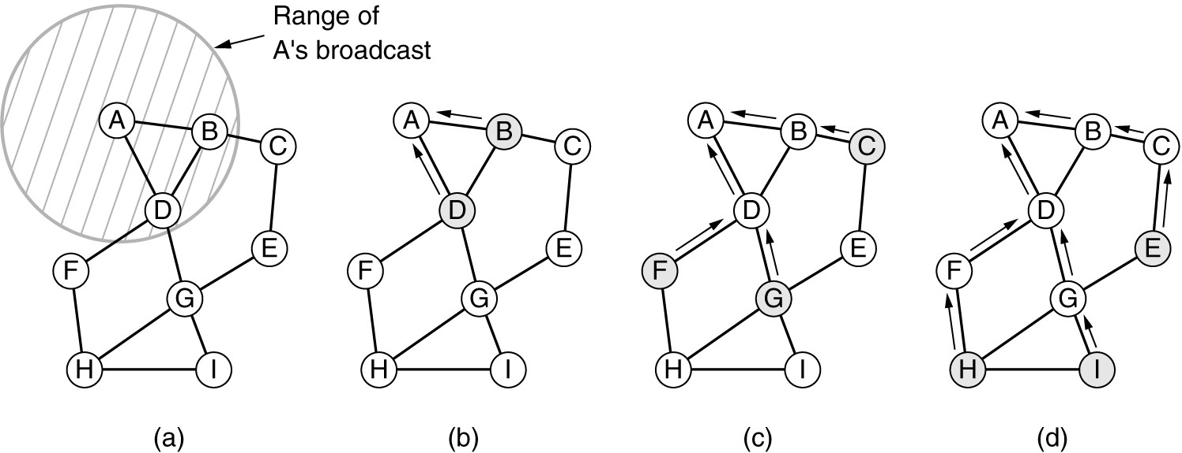
Route Discovery
(a) Range of A's broadcast.
(b) After B and D have received A's broadcast.
(c) After C, F, and G have received A's broadcast.
(d) After E, H, and I have received A's broadcast.
Shaded nodes are new recipients. Arrows show possible reverse routes.

Slide 25
Route Discovery (2)
Format of a ROUTE REQUEST packet.

Slide 26
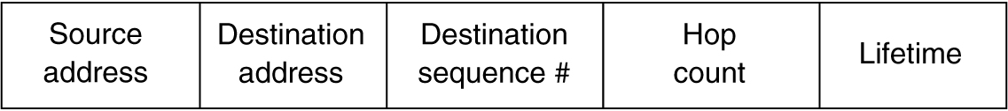
Route Discovery (3)
Format of a ROUTE REPLY packet.

Slide 27
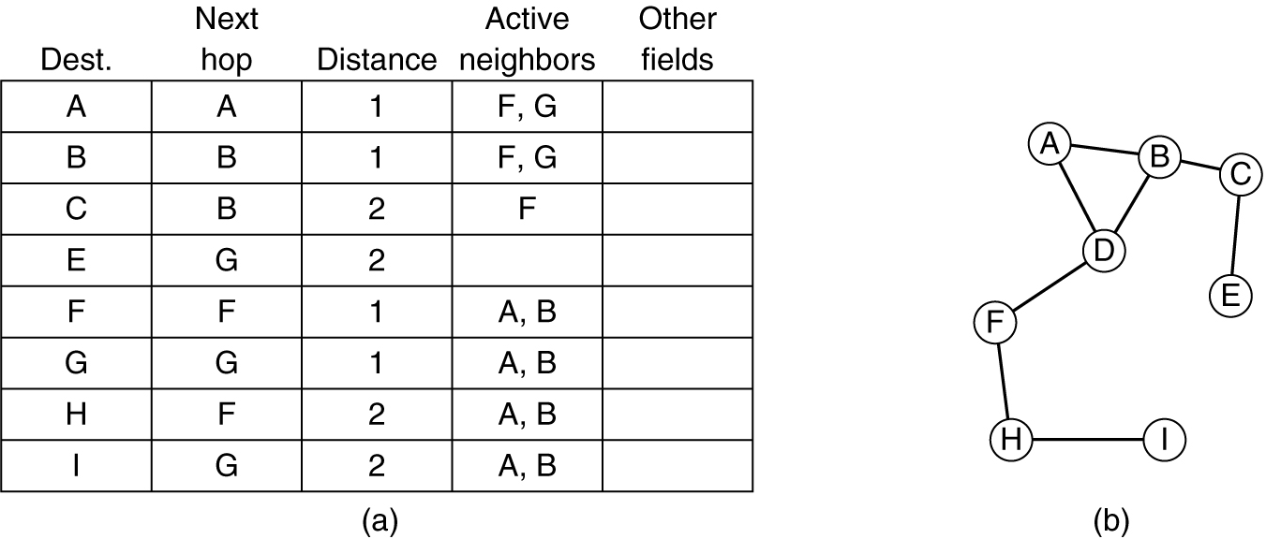
Route Maintenance
D's routing table before G goes down.
The graph after G has gone down.

Slide 28
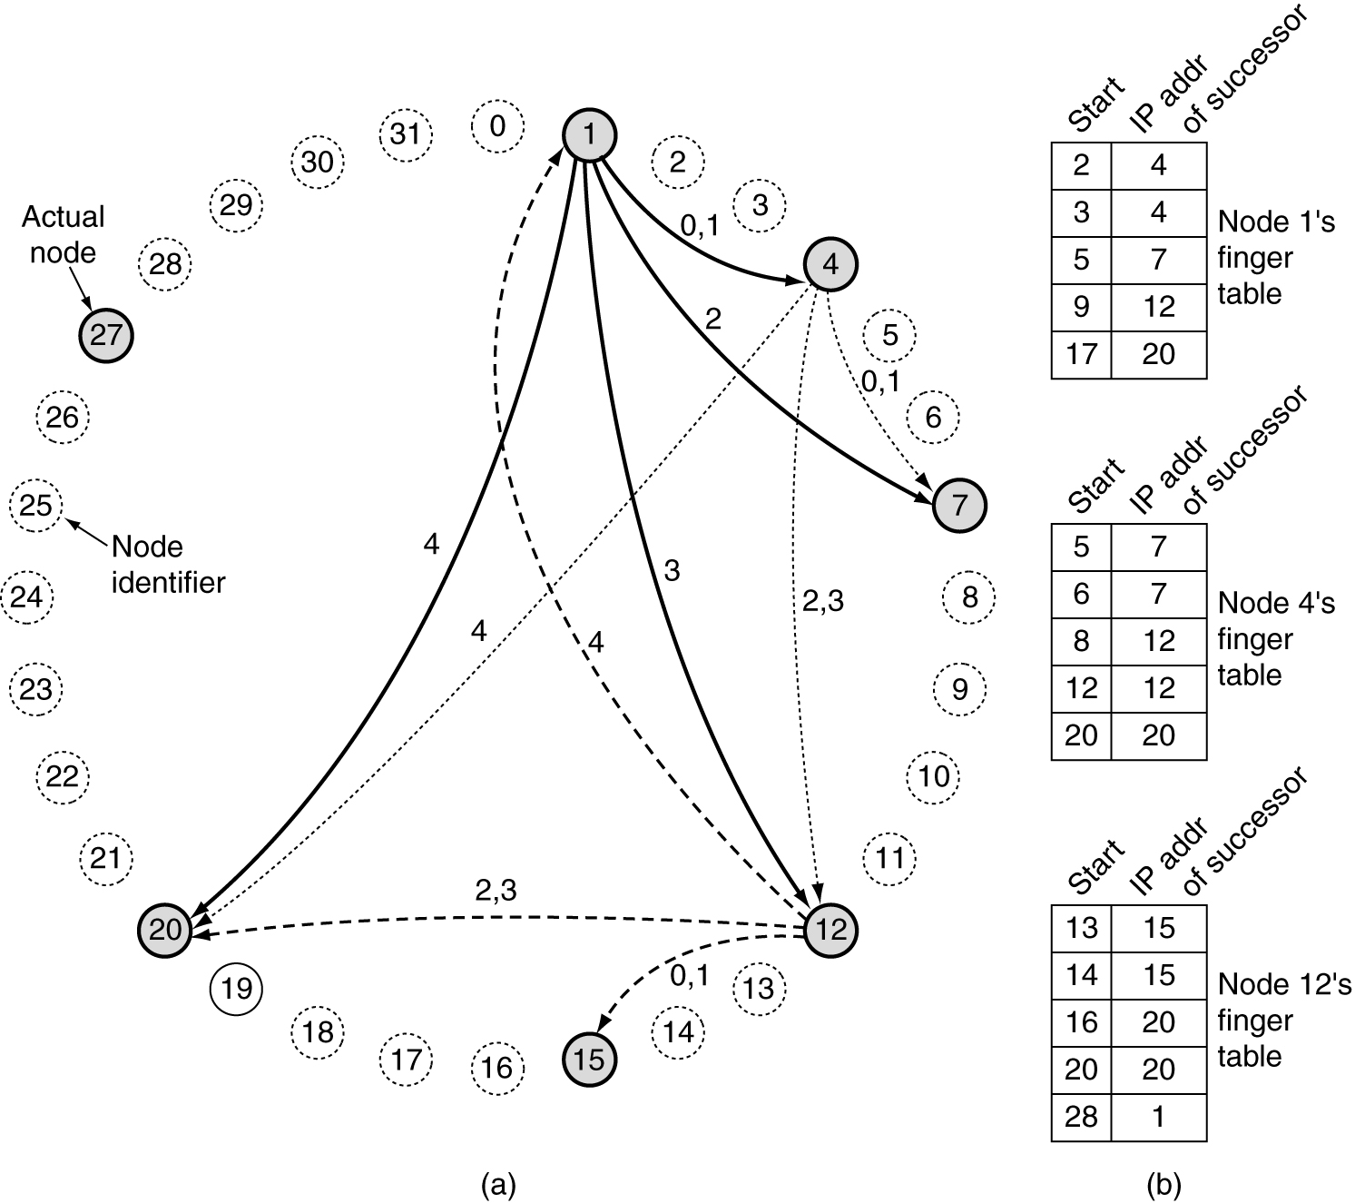
Node Lookup in Peer-to-Peer Networks
A set of 32 node identifiers arranged in a circle. The shaded ones correspond to actual machines. The arcs show the fingers from nodes 1, 4, and 12. The labels on the arcs are the table indices.
Examples of the finger tables.

Slide 29
Congestion Control Algorithms
•
•
•
•
•
•
General Principles of Congestion Control Congestion Prevention Policies
Congestion Control in Virtual-Circuit Subnets Congestion Control in Datagram Subnets Load Shedding
Jitter Control

Slide 30
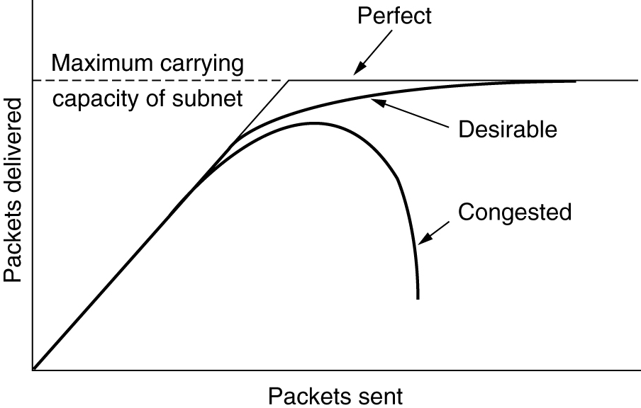
Congestion
When too much traffic is offered, congestion sets in and performance degrades sharply.

Slide 31
General Principles of Congestion Control
1. Monitor the system .
– detect when and where congestion occurs.
Pass information to where action can be taken.
Adjust system operation to correct the problem.

Slide 32
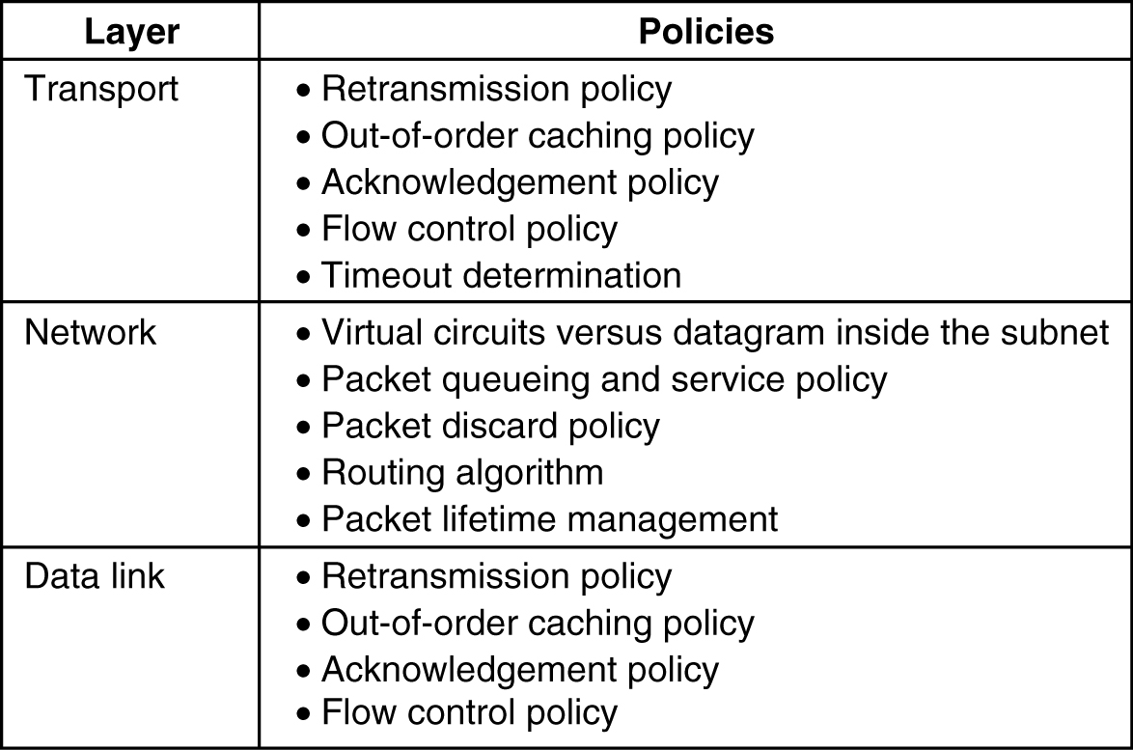
Congestion Prevention Policies
5-26
Policies that affect congestion.

Slide 33
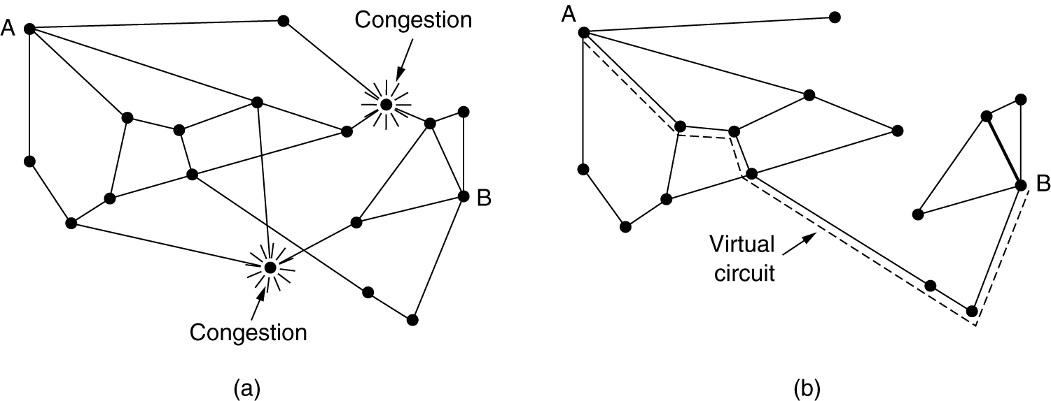
Congestion Control in Virtual-Circuit Subnets
(a) A congested subnet. (b) A redrawn subnet, eliminates congestion and a virtual circuit from A to B.

Slide 34
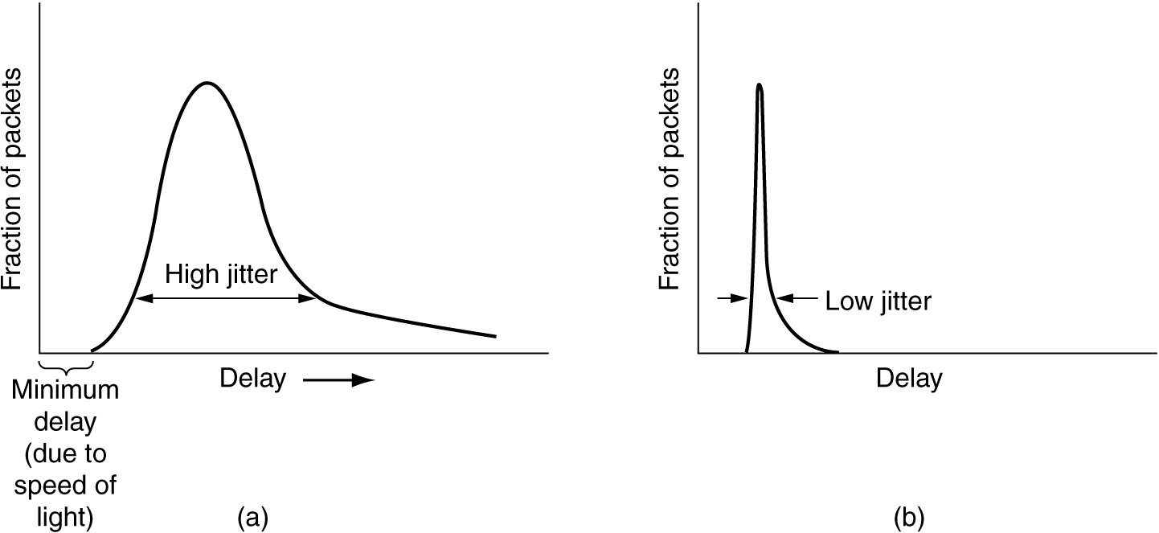
Jitter Control
(a) High jitter.
(b) Low jitter.

